Slide 1
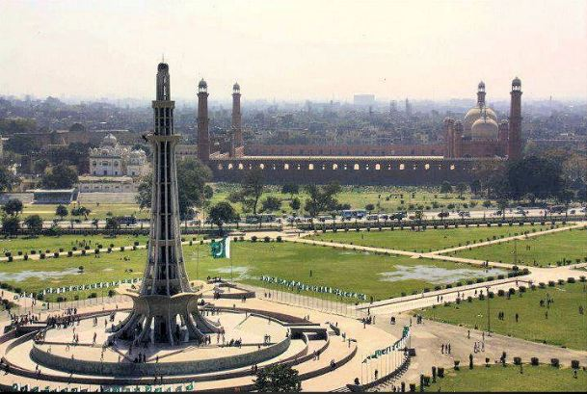
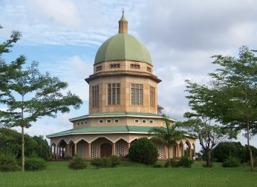
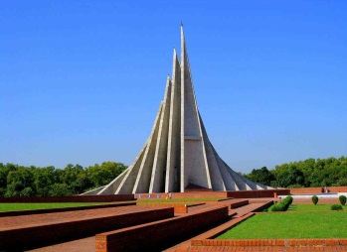
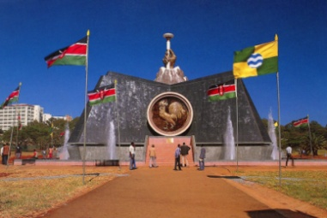
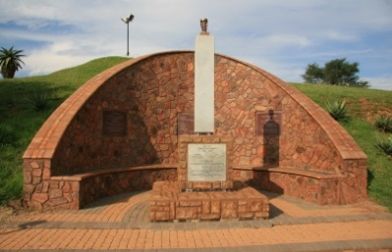
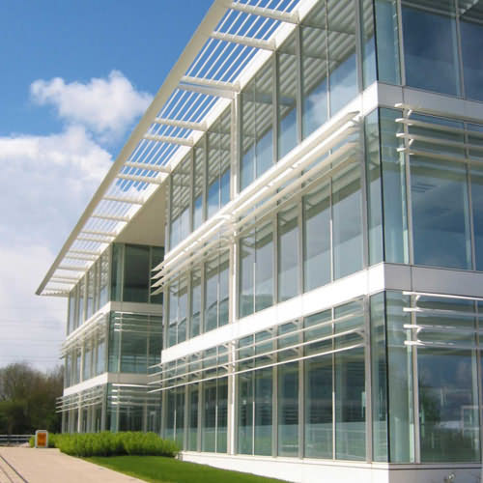
Fairmont royal innovative education system
Turning your aspirations into reality
Our International Partners :
United Kingdom / Indonesia / Tanzania / Kenya / Greece / Bangladesh Canada / Uganda

Slide 2
Company Profile
FAIRMONT ROYAL LIST OF COMPANIES
Fairmont Royal Innovative Education System
Fairmont Royal Hospitality & Tourism
Fairmont Royal Geo Exploration Energy & Environment
Fairmont Royal Human Resource Development
Fairmont Royal Health Care Services
Fairmont Royal Construction Designers & Developers
Fairmont Royal IT Data Management & Research Services
Fairmont Royal Imports and Exports
Fairmont Royal Events Management
Fairmont Royal Fisheries & Aquaculture
Fairmont Royal Food & Agriculture
Fairmont Royal Business Asset & Policy Consultants
Fairmont Royal Mining & Gemstones
Fairmont Royal Industries
Fairmont Royal Legal & International Development Consultancy
Fairmont Royal Sports Entertainment and Recreation
Fairmont Royal Media & Telecommunication Services

Slide 3
Our Vision / Mission & objective
Our Vision
Our vision is to promote quality education, prepare the youth for challenging future by enhancing employability skills while connecting them to global institutions and organizations.
Our Mission
FRIES aims to empower our students through education and help them change their lives for the better and is dedicated to fostering intellectual growth, aesthetic appreciation, and character development in our students. Our programs integrate global awareness, employability skills, communication skills and team building across the curriculum; We provide the best possible education to those who need it at an affordable price, giving people from all walks of life the opportunities they need to improve their career prospects.
Our Objective
The purpose of UK Employability Certificates is to train higher secondary & graduate youth and adults of our country in various sectors for their global employment and future careers.

Slide 4
OUR TEAM MESSAGES

Slide 5
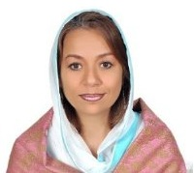
AMB. RUBINA H. ALI
High Commissioner – Asia / Africa – UN SDG’s – WHC
Ambassador in Residence (Pakistan) – WHC
Vice President – Asia / Africa to liaise with The United Nations (UN) – WHC
Ambassador – A.N.G.E.L Foundation
Deputy Foreign Minister (Asia) – WHC
Founder President - Global Learning Trust
Chief Executive Officer – Fairmont Royal Group of Companies
Message:
Our Vision is to foster services and activities that will encourage healthy connections among different stakeholders both domestically and globally

Slide 6
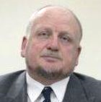
HIS IMPERIAL GRACE SIR LESLIE R ANGELL
HON. CHAIR OF FAIRMONT ROYAL
Royal & Diplomatic Ambassador ​
Duke de Lys: Capadocia & Neapolis
Lord Marshall of Europe
Knight Commandant of the Heredity Commander of England
Ministerial Chief of Staff & Inter-government Diplomatic
Inspector General (DFA) - World Humanity Commission
Registered Diplomatic Officer to The United Nations
Minister of Foreign Affairs – WHC
High Commissioner Consul General to the Embassy of WHC in Pakistan & Asian Diplomatic Quarters
Minister of Foreign Affairs / Diplomatic Inspector General for the A.N.G.E.L. Inter-Governmental Organization
PRIVY Councilor of UK
Message:
In my appointment to this auspicious organization, Company and Foundation. I am delighted to say how pleased I am that such a structure has been formed to be of benefit to the people of Pakistan, not only in foreign links outside the country but by trying to show the people that entitles do care and will strive for "NO CORRUPTION, NO CRIMINALITY AND TOTAL TRANSPARENCY" equally commercially, politically and socially. I look forward to progress from the foundations which have been laid down over many years.

Slide 7
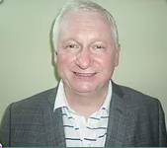
DR MIKE DILLON
INTERNATIONAL PRINCIPAL OF FRIES
Chief Executive Officer of Institute of Productivity
Vice-President of the World Network of Productivity Organizations
World-renowned Expert on manufacturing strategy and on the seafood sector and has been on international projects, working with UNIDO and the World Bank
Message:
The new academic team will ensure the students become a resource of change leaders in business performance to improve the livelihood of the local people and assist in the economic growth of Pakistan. As the Ex-Vice Principal of one of the UK top 10 vocational institutes delivering strategically planning and delivery programs from short courses to masters degrees, we would love to bring the same quality of delivery to our new institute and the passion to help our learners achieve practical skills and academic knowledge needed for effective work.

Slide 8
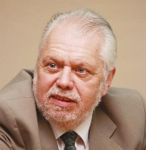
JOHN HEAP
UK PARTNER OF FRIES
Managing Director of Institute of Productivity
President of the World Confederation of Productivity Science
President of the European Association of National Productivity Centers
Message:
The Institute is pleased and honored to be able to help students in Pakistan to improve their employability and career prospects. At the same time, in line with our core philosophy. I believe we are making a significant contribution to the future, social, environmental, and economic development of Pakistan.

Slide 9
Intro - Level 3 - 4
LEVEL 3 – 4 COURSES (UK):
Our comprehensive range of Level 3 - 4 UK courses has been designed to ready you for career success in diverse industry sectors.
These specialized one year programs deliver the practical, real world skills you require to excel in various areas.
Whether you opt to enter the workplace or continue on to the Honors Degree, a Level 3 – 4 UK Courses of Fairmont Royal is the first step to achieving your ambitions.

Slide 10
Procedure
Level 3 will be covered within 3 months or earlier depending on the previous qualification and the modules include Mathematics (Numerics / Calculations / Analysis) IT / English Conversation / Personality Development.
Level 4 (1st part) will be covered in 4 months with performance management for employability skills
Level 4 (2nd part) will be covered in 1 month with employability skill practical on a selected module
The Level 4 (3rd part) will be covered in 1 month with a major assignment to submit to the university
When the students are done with level 3 & 4 they will have 2 options:
Option 1: Study their degree around the world with employability certificate credits
Option 2: Get a job in Pakistan / Abroad with this employability certificate

Slide 11
MODULES
Food and Hospitality Management
Productivity & Logistics
Information Technology Practitioner – Data Analytics
Agriculture Technology – Fisheries / Livestock / Dairy / Crops
Food Safety & Technology
Food Chain Management & Retail

Slide 12
SUBMODULES
Continuous Improvement
Strategic Planning
Risk & Issue Management
Performance Measurement & Management
Quality Management for Improved Productivity
Organizational Development for Improved Productivity
Project Planning & Control
Planning for Operational Change
Innovation & Creativity
Leadership & Management
Designing & Implementing a Balanced Scorecard
Using Benchmarking to Improve Performance
Production Engineering
Workforce Planning to Improve Productivity
Mobile Technologies for Improved Productivity
Problem Solving for Business
Reducing Waste to Improve Productivity
Costing & Financial Control

Slide 13
KEY BENEFITS
LEVEL 3 – 4 COURSES (UK):
Comprehensive e-learning
After completion the candidates are able to qualify for global employment on merit.
Global Networking & Public Relations
Scholarships for further studies abroad are also available
Its time saver course students are only getting prepared in shortest possible period for their further studies at various universities for next three to four years

Slide 14
REQUIREMENTS
Age: 18 and Above
Intermediate / A level / Undergraduate / Graduate
Mandatory 60% Attendance in the classroom

Slide 15
FRIES Fee Schedule
LEVEL 3 - 4 UK COURSES: Application Fee: 1500 PKR Admission Fee: 5,000 PKR Tuition Fee - Yearly: Rs.279,000
Months | Tuition Fee | Internship Payroll | Out of Pocket Exp
1 | PKR 20,000 | PKR 12,000
2 | PKR 20,000 | PKR 12,000
3 | PKR 20,000 | PKR 12,000
4 | PKR 20,000 | PKR 25,000
5 | PKR 20,000 | PKR 25,000
6 | PKR 20,000 | PKR 25,000
7 | PKR 53,000 | PKR 25,000
8 | PKR 53,000 | PKR 35,000
9 | PKR 53,000 | PKR 35,000
Total | PKR - 279,000 | PKR - 206,000 | PKR - 73,000

Slide 16
OUR INDUSTRIAL COURSES (USA)

Slide 17
OUR INDUSTRIAL COURSES (USA)
Advanced Procurement Negotiations
Audit, Compliance & Regulation
Business Development, Social Media & Marketing
Change Management and Change Leadership
Coaching & Executive Management Strategy
Commercial Audit - Internal Audit & Best Practice
Contractor Purchasing System Review (CPSR)
Cost Reduction and Supplier Partnership
Effective Bid & Tender Strategies for the Oil & Gas Industry
Effective Vendor Spend Management & Strategies
Human Resources: Strategic & Tactical
Procurement Audit & Procurement System Development
Procurement Cost Reduction
Procurement Process & Solutions
Vendor / Supply Chain Management
Organizational Compliance SOP's

Slide 18
OUR NATIONAL COURSES

Slide 19
OUR NATIONAL COURSES
IELTS –
4 Weeks | Fees: PKR 5000 /= | Per Month
English Conversation –
8 Weeks | Fees: PKR 5000 /= | Per Month
English for Diplomats –
8 Weeks | Fees: PKR 20,000 /= | Per Month
Computer Basics –
4 Weeks | Fees: PKR 2500 /= | Per Month
Office Management –
6 Weeks | Fees: PKR 2500 /= | Per Month
Graphic Designing –
8 Weeks | Fees: PKR 2500 | Per Month
Quickbooks
4 Weeks | Fees: PKR 5000 /= | Per Month
Digital Marketing – 2 months
8 Weeks| Fees: PKR 2500 /= | Per Month

Slide 20
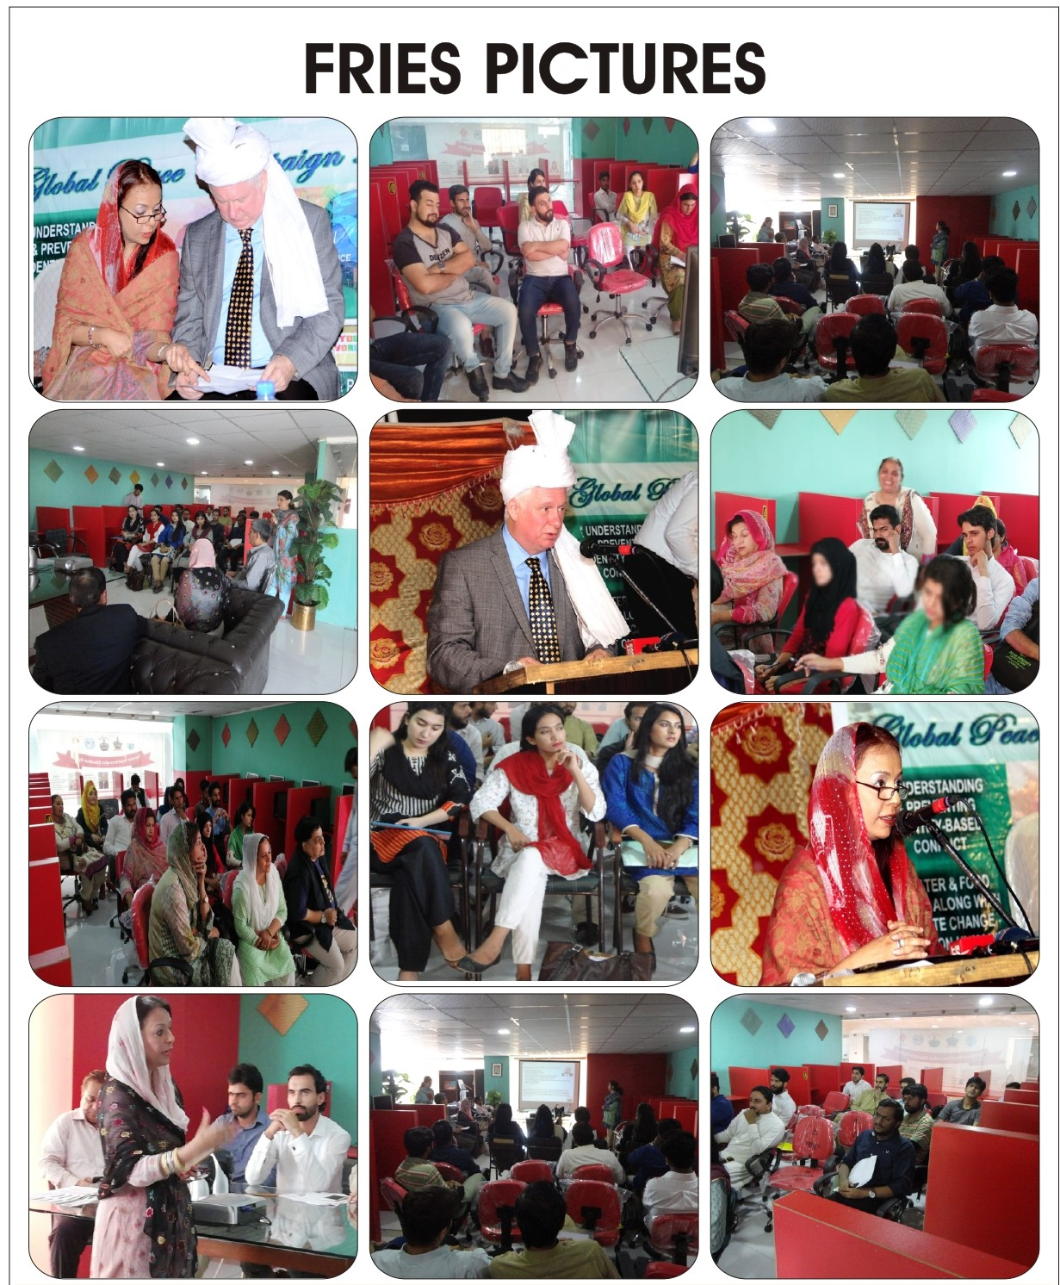
FRIES PICTURE GALLERY

Slide 21
CONTACT US
Address: Office #16, 3rd floor, Mall 9, G9 Markaz, Islamabad
Email Address: frinnovativeeducationsystem@gmail.com
fairmontroyalgroupofcompanies@gmail.com
Website:
www.freducation9.wixsite.com/fries
www.globallearningtrust.wixsite.com/trust
www.frgoc9.com

Slide 22
Thank You

